Slide 1
IMPLEMENTATION OF NFC ON WEARABLE OBJECTS Under the guidance of Dr. B. N. Bhandari Professor of ECE Department
Submitted by:
MADIRAJU ANIRUDH SAI 17011M2001
SIDDAVATAM.SALMANUDDIN AHAMAD 17011M2005
D.L.V.R SUDHEER 17011M2006
KANDALA HEMANTH 16011M2013

Slide 2
PROJECT AIM:
Sharing, storing private information like Aadhar card number in a ring or any customized object using Near Field Communication (NFC) and microcontroller.

Slide 3
OBJECTIVES:
Designing coil on any customized object in which we want to store the information.
Coding of NFC tag using Arduino for storing and sharing the information when required using NFC reader.
Using the object, one can access personal information and it’ll be within reach at all times.
Sharing the information will be possible through simple tap of that object on the NFC reader, NFC tag does not need any power source making it even more accessible.

Slide 4
INTRODUCTION:
Sub technology of RFID is NFC, in RFID far field communication takes place through radio frequency reflectors and antennas. But in NFC, communication takes place through mutual inductance.
NFC is near field communication which is a wireless short-ranged communication system where mutual inductance and load modulation is used for the short-ranged communication to work.
This requires a transmitting device and a receiving device (passive). The information is stored inside an NFC tag from which the information is sent to devices, in which load modulation can be detected.

Slide 5
NFC standards cover communications protocols and data exchange formats and are based on existing radio-frequency identification (RFID) standards including ISO/IEC 14443.
The standards include ISO/IEC 18092 and those defined by the NFC Forum. In addition to the NFC Forum, the GSMA group defined a platform for the deployment of GSMA NFC Standards within mobile handsets. GSMA's efforts include Trusted Services Manager, Single Wire Protocol, testing/certification and secure element.
NFC uses inductive coupling between two nearby loops effectively forming an air-core transformer.
Present and anticipated applications include contactless transactions, data exchange and simplified setup of more complex communications such as Wi-Fi.

Slide 6
DESIGN ASPECTS :
To achieve the required objectives foresaid , the following hardware parts are utilized in this project :
ARDUINO UNO
RC522 (NFC READER/WRITER)
NTAG 213
LCD DISPLAY (20X4)
PUSH BUTTONS

Slide 7
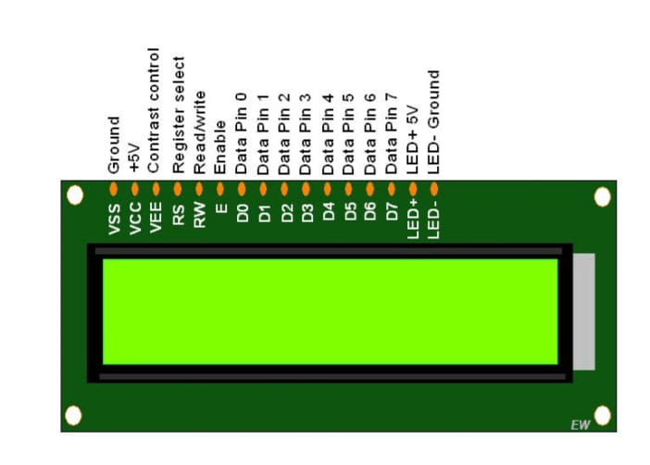
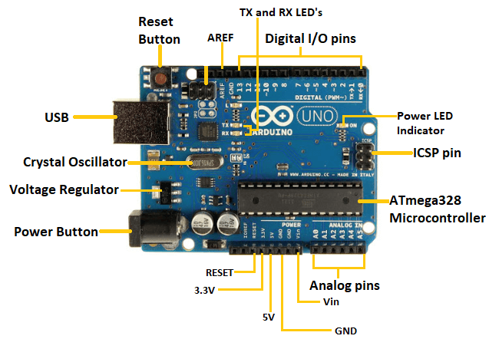
ARDUINO UNO:
LCD DISPLAY (20x4):

Slide 8
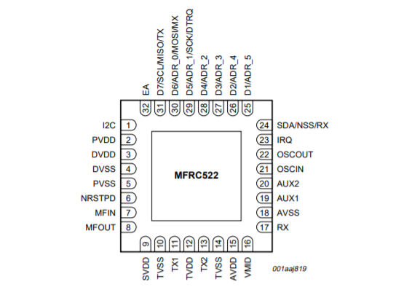
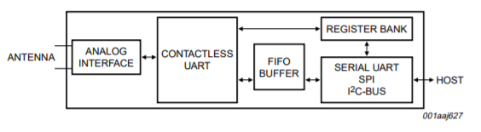
RC 522 PIN OUT:
NFC READER BLOCK DIAGRAM:

Slide 9
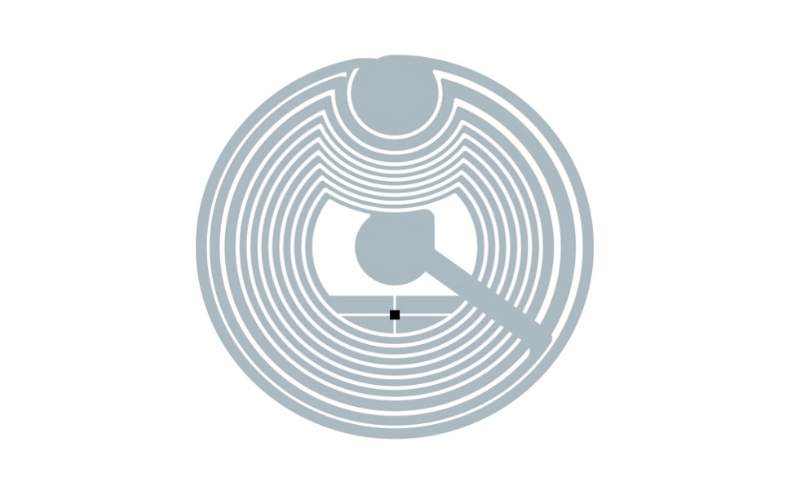
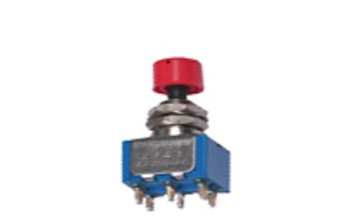
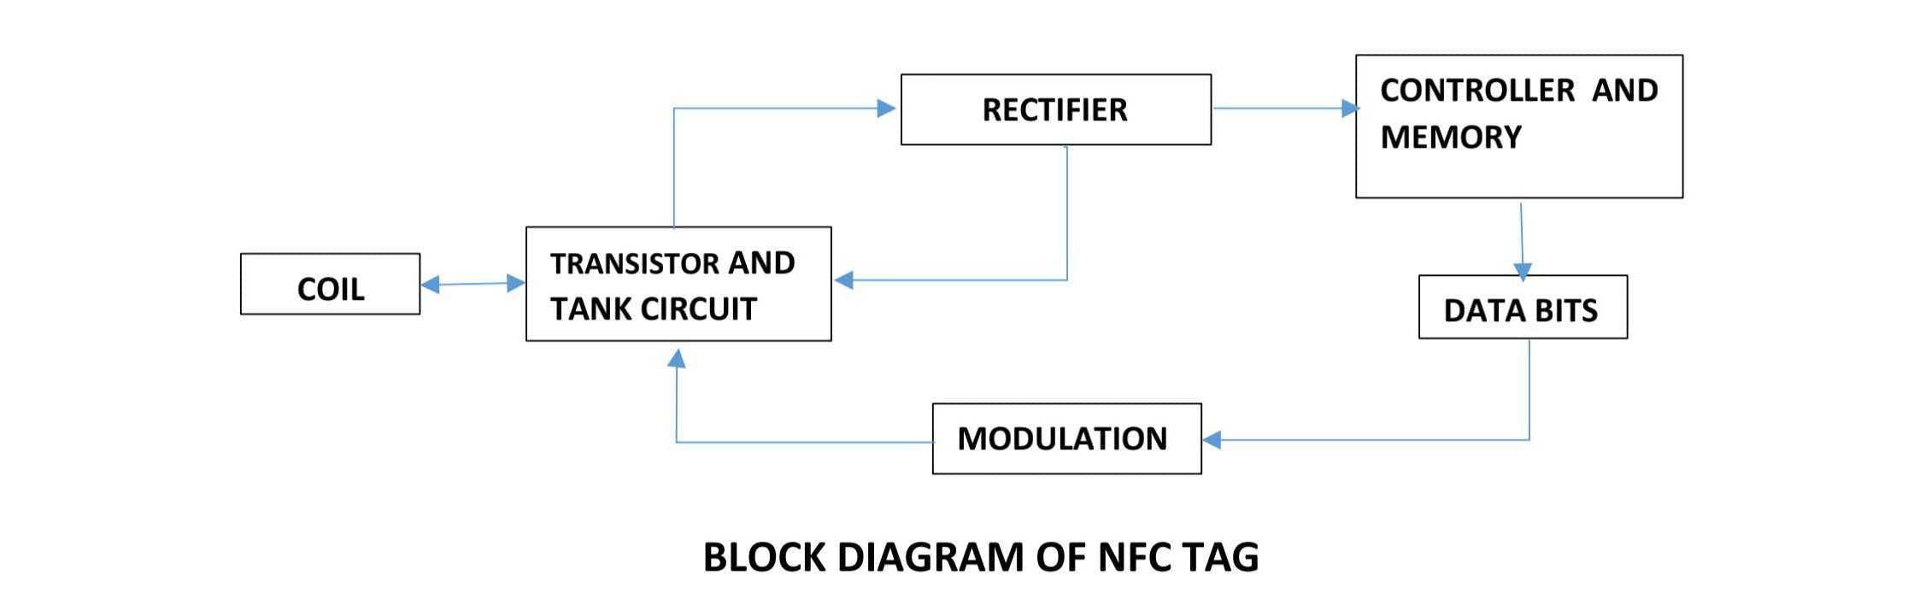
NTAG 213:
PUSH SWITCH:
Block diagram of NFC tag:

Slide 10
RFID RC 522 NFC READER:
The MFRC522 is a highly integrated reader/writer IC for contactless communication at 13.56MHz. The MFRC522 reader supports ISO/IEC 14443 A/MIFARE mode.
The MFRC522 supports contactless communication and uses MIFARE higher transfer speeds up to 848 kBd in both directions.
NTAG 213 :
Data transfer takes place when mutual induction between primary coil (nfc reader) and secondary coil (ntag 213 coil) is established.
Data retrieval and data storage takes place through addressing mechanism.
Total of 144 bytes of memory storage is available.
Data transfer speed goes upto 106 kbits/s.

Slide 11
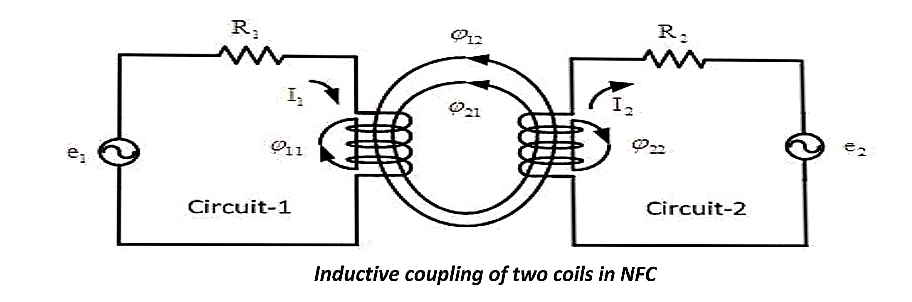
LOAD MODULATION:
The above circuit shows the effect of mutual coupling, the primary coil (circuit 1 represents coil present in NFC reader module ) and secondary coil ( circuit 2 represents coil in Ntag 213 sticker ).
After coupling is established, I2 flows in circuit 2, and whenever R2 is varied, I2 is effected which in turn affects I1 and voltage across R1 varies accordingly.
Hence data is transmitted by varying load, so it is nick named as LOAD MODULATION. This is the technique utilized by NFC devices to transfer data without using antennas.

Slide 12
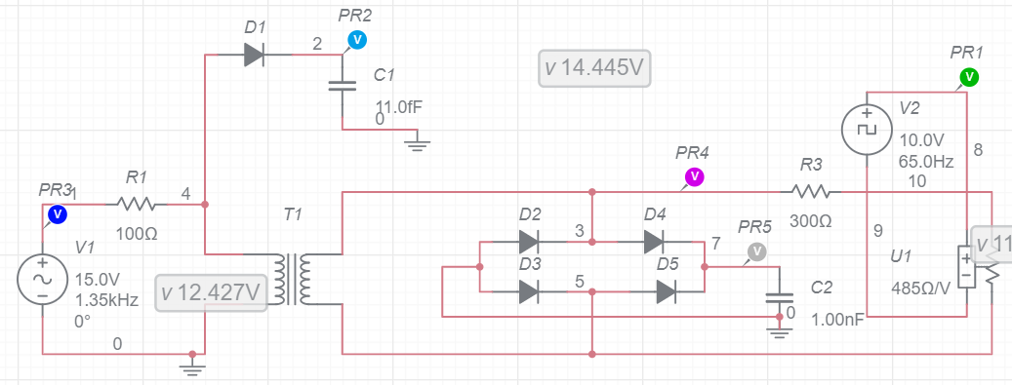
Simulation of NFC tag:
This is the circuit used to simulate how the NFC tag and reader works, in Multism , at the primary coil we send in Alternating Current for the coupling to take place and the current is transferred to the secondary coil through Mutual Inductance.

Slide 13
This AC is converted to DC using bridge rectifier which is used as power source by the chip (here chip is not used, so connection is left as it is ), then the memory is accessed by addressing and data present on that address is used to modulate resistance on the secondary coil, as the resistance changes the power induced changes hence resulting in change of current drawn from primary coil.
Here instead of data, square wave is used to represent data. As resistance is varied according to the data , this scheme of modulation is nick named as load modulation.
Data transmission in NFC is based on load modulation and the resulting wave form will be amplitude modulated as shown in the figure below, the data is recovered through envelop detector which gives the trace of positive side of wave form.
All of the simulated wave forms are shown below, these wave forms are colored and represent the signal at the particular point in the circuit.

Slide 14

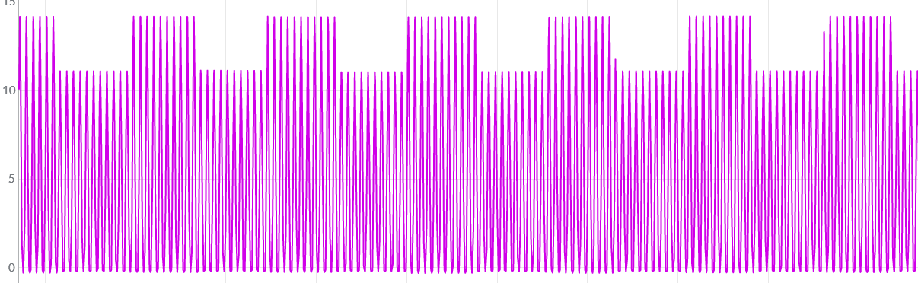

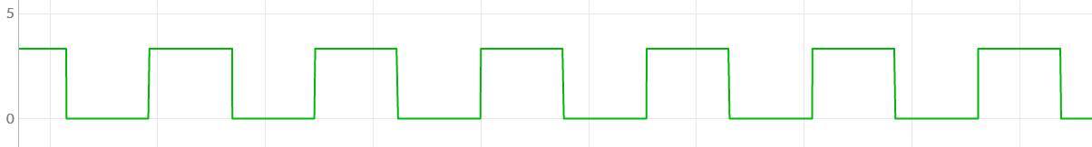
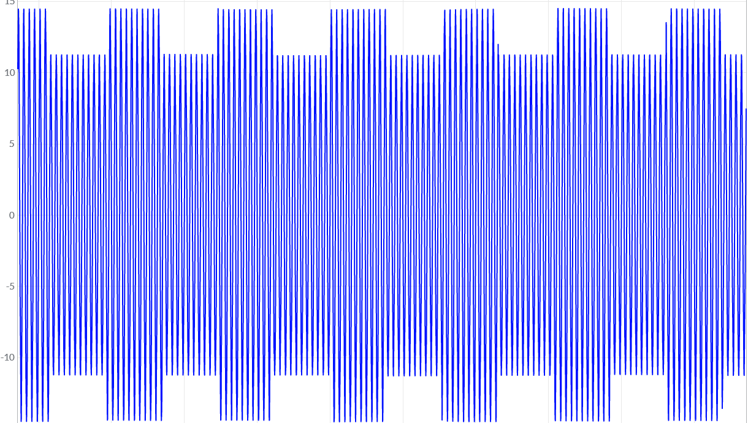
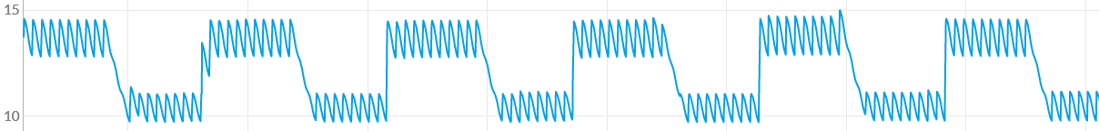
Ac voltage
Secondary coil voltage
Dc voltage derived
Data stored in tag
Load modulation effect
Envelop detector
WAVEFORMS OBTAINED FROM ABOVE CIRCUIT:

Slide 15
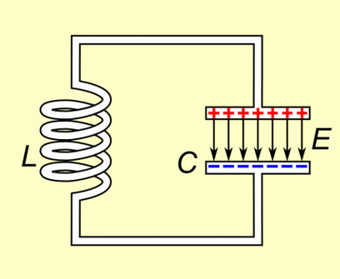
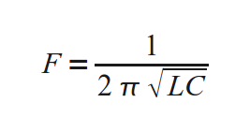
FREQUENCY SELECTION:
This is the circuit used to tune circuits to certain frequency which will be needed in various circuits. In NFC the optimum frequency needed is 13.56MHz. Here the Inductance and Capacitance will be calculated for the required frequency using the formula mentioned above. Depending on the availability the inductor, capacitor is selected.

Slide 16
NFC DESIGN IN OBJECTS:
The shape of the coil will not be the same in different objects.
Inductance value changes with number of turns in coil as well as the shape of the coil, because different shapes will have different distances when measured from object’s center to end point on a coil.
Because of this calculating inductor value is necessary and after calculating inductance, capacitor can be chosen by finding ‘C’ in the above formula.
The inductances of different shapes is shown in the reference paper [3].
Minimum voltage needed should be decided based on the chip used in NFC.
Then from this number of turns needed in coil can be calculated based on this formula,
N1/N2 = V1/V2
Find number of coils helps in finding out inductance provided by that shape of coil and number of turns.
To tune to a particular frequency tank circuit principle is used, as inductance is known, capacitance can be found through this formula,

Slide 17
NFC READER DESIGN:
Different personal information can be stored in NFC tags like aadhar, pan card…
But if every time all of the data in NFC tag is transferred to reader, it is not secure and favourable.
To avoid this, a unique identifier to each reader must be implemented such that only the data required is read and other data is dumped.
Unique identifiers help NFC reader to be able to read particular data from NFC tags.
In this project to show this idea, unique identifiers is replaced with switches to emulate unique identifiers.
As NFC tag is a passive device, less work needs to be done by it.

Slide 18
Write algorithm:
Read algorithm:
start
start
Initialize SPI
Initialize SPI
no
Tag present?
Tag present?
no
yes
yes
end
Read switch i/p
Address = 0x06
Switch 1 ?
Write data at adr
yes
no
Increment adr by 4
end
Switch 2 ?
yes
Display data
no
yes
Var > 0x13
yes
no
yes
Switch 3 ?
Switch 4 ?
Display success
no

Slide 19
RESULTS:
We were able to store the required data, which is:
Aadhar Card Number
PAN Card number
College ID Card
Driving License
These details were stored in the NFC chip through writing code shown above and we have been able to read this data successfully through the reading code shown above . This data is displayed in the LCD that we used.
The above shown data is just only a part of what can be stored. This can also be used to store payment information as well and can be used to pay for goods, but this will require encryption of data so that relaying attacks can be avoided. Encryption is further extension of this project and in the final outcome will be complete storage of personal information in wearable objects.

Slide 20
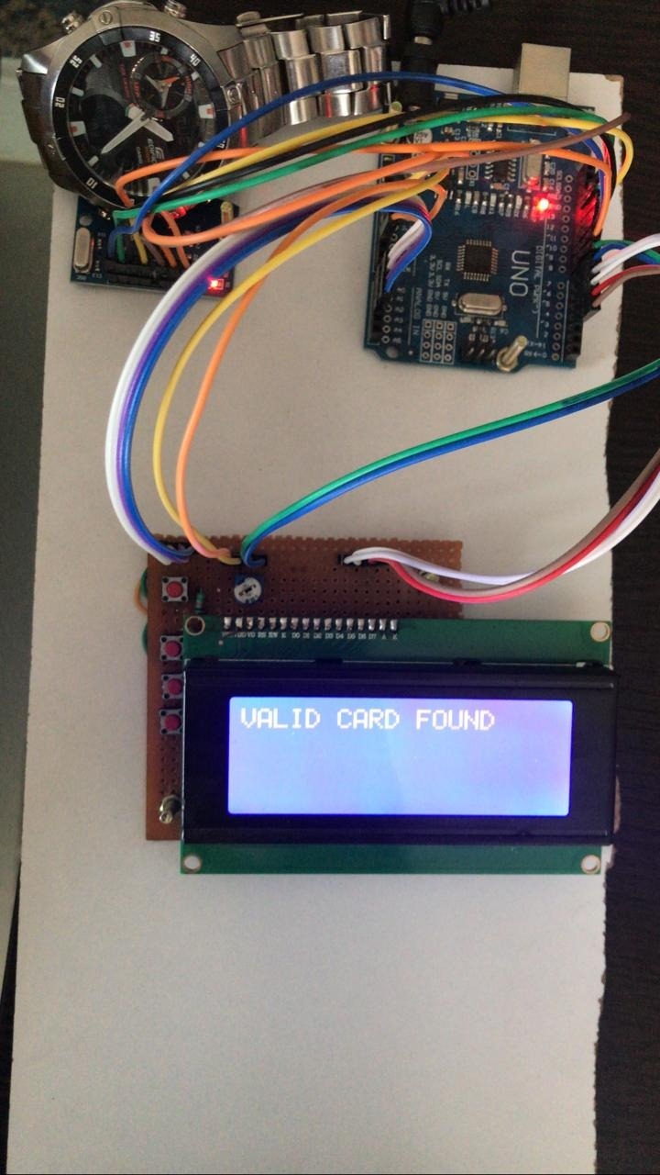
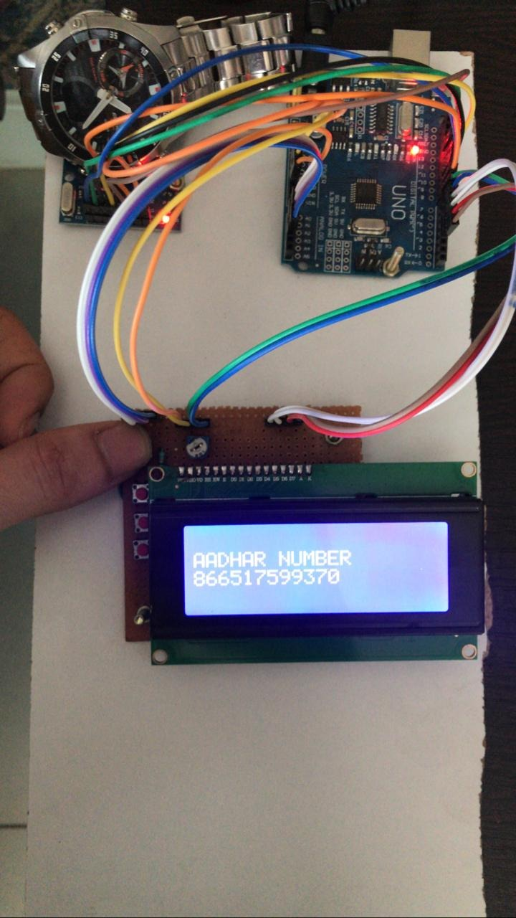
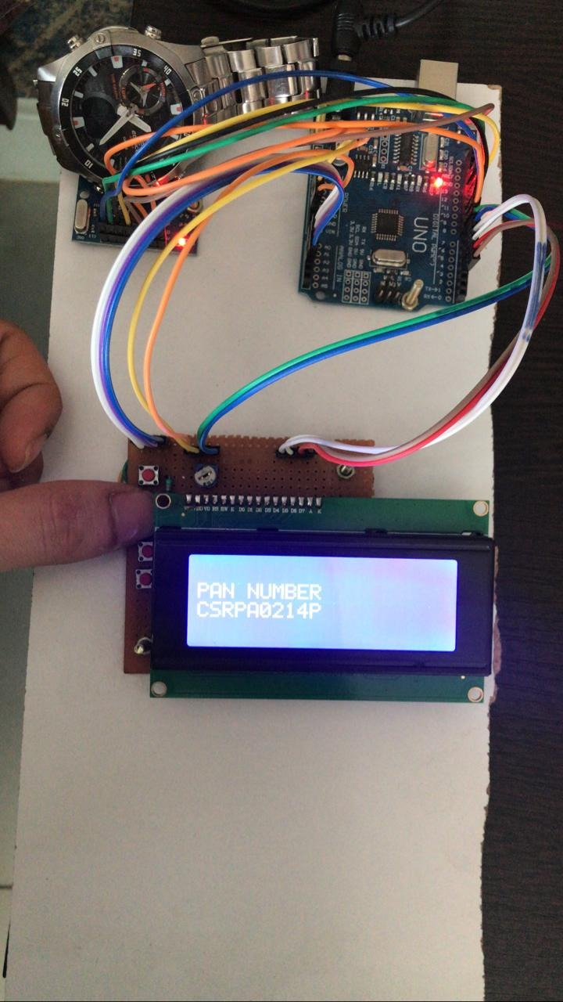
Whether it is valid or not
Aadhar details
Pan details

Slide 21
Through this we have achieved a transmission distance of upto 10 cm in an open environment and upto 6 cm in environment where metal objects are present in the near vicinity of NFC tag. Even more distances can be achieved by increasing the magnetic field strength of NFC reader.
What we have done is just a small part which can be further developed and can be implemented in various places where we may need to show our personal identity and can be used for payment interfaces as well.
New technologies take time for full utilization by the public and this project displays its potential in this real world. In India many don’t know how to use a mobile phone so to provide personal info such as aadhar, pan… they use papers and these cause damage to our environment, by implementing this at places where it is required most will help reduce the paper consumption and it is actually cheaper than a paper in the long run, because storing in tag needs to be done only once and this tag can be used for all the above said purposes.
NFC in personal objects is passive, so recharging this tag is not necessary and this also follows the “plug and play” objective in the real world.

Slide 22
CONCLUSION:
NFC is a new technology which makes lives easier and has a wide range of applications.
In our project we have used NFC for the purpose of showing personal identification to others when required. By using a chip, which have been embedded in a small sticker, we can stick it on to any object and use it to show the data present.
This makes it easier for anyone to have the data and just put it on an NFC reader and this reader reads the required data.
We can reduce the number of cards we carry in a wallet everyday and instead use NFC in order to store all the card information in a personal object. This hence gives us an easier way to show our personal identity whenever it is required.

Slide 23
FUTURE SCOPE:
Our project gives us the use of NFC to send personal identification using NFC Tag and Mutual Inductance. By using more sophisticated equipment, a more efficient way to transfer data can be done.
Developing NFC to transfer data at higher rates will help in using this technology for internet surfing, and the host can carry a passive device and when ever he/she needs internet, they can be near a NFC transmitter and they’ll be able to connect to internet with a passive device!
Hash codes can be used to identify a person, as hash codes are unique they can be given to a particular person and that person can use it through NFC to prove his/her identity in working environment.
Data can be encrypted in NFC tag which will provide safety to the information stored, if at all host loses personal object.

Slide 24
REFERENCES:
[1]https://www.arduino.cc/datasheets
[2] https://www.arduino.cc/hardwarespecs
[3] https://www.augmented.life.com/an2866
[4]https://arduino.cc/sofware/package
[5] www.futurlec.com/LED/LCD20X4.shtml
[6] http://www.nxp.com/docs/en/data-sheet/MFRC522.pdf
[7] pdf1.alldatasheet.com/datasheet-pdf/view/531146/NXP/NTAG213.html [8]https://www.github.com/NFC
[9]https://www.ISO.org/NFC
[10]http://www.ieeexplore.com/NFCreader

